Slide 1
Jumbo Project
Yellow & Green teams

Slide 2
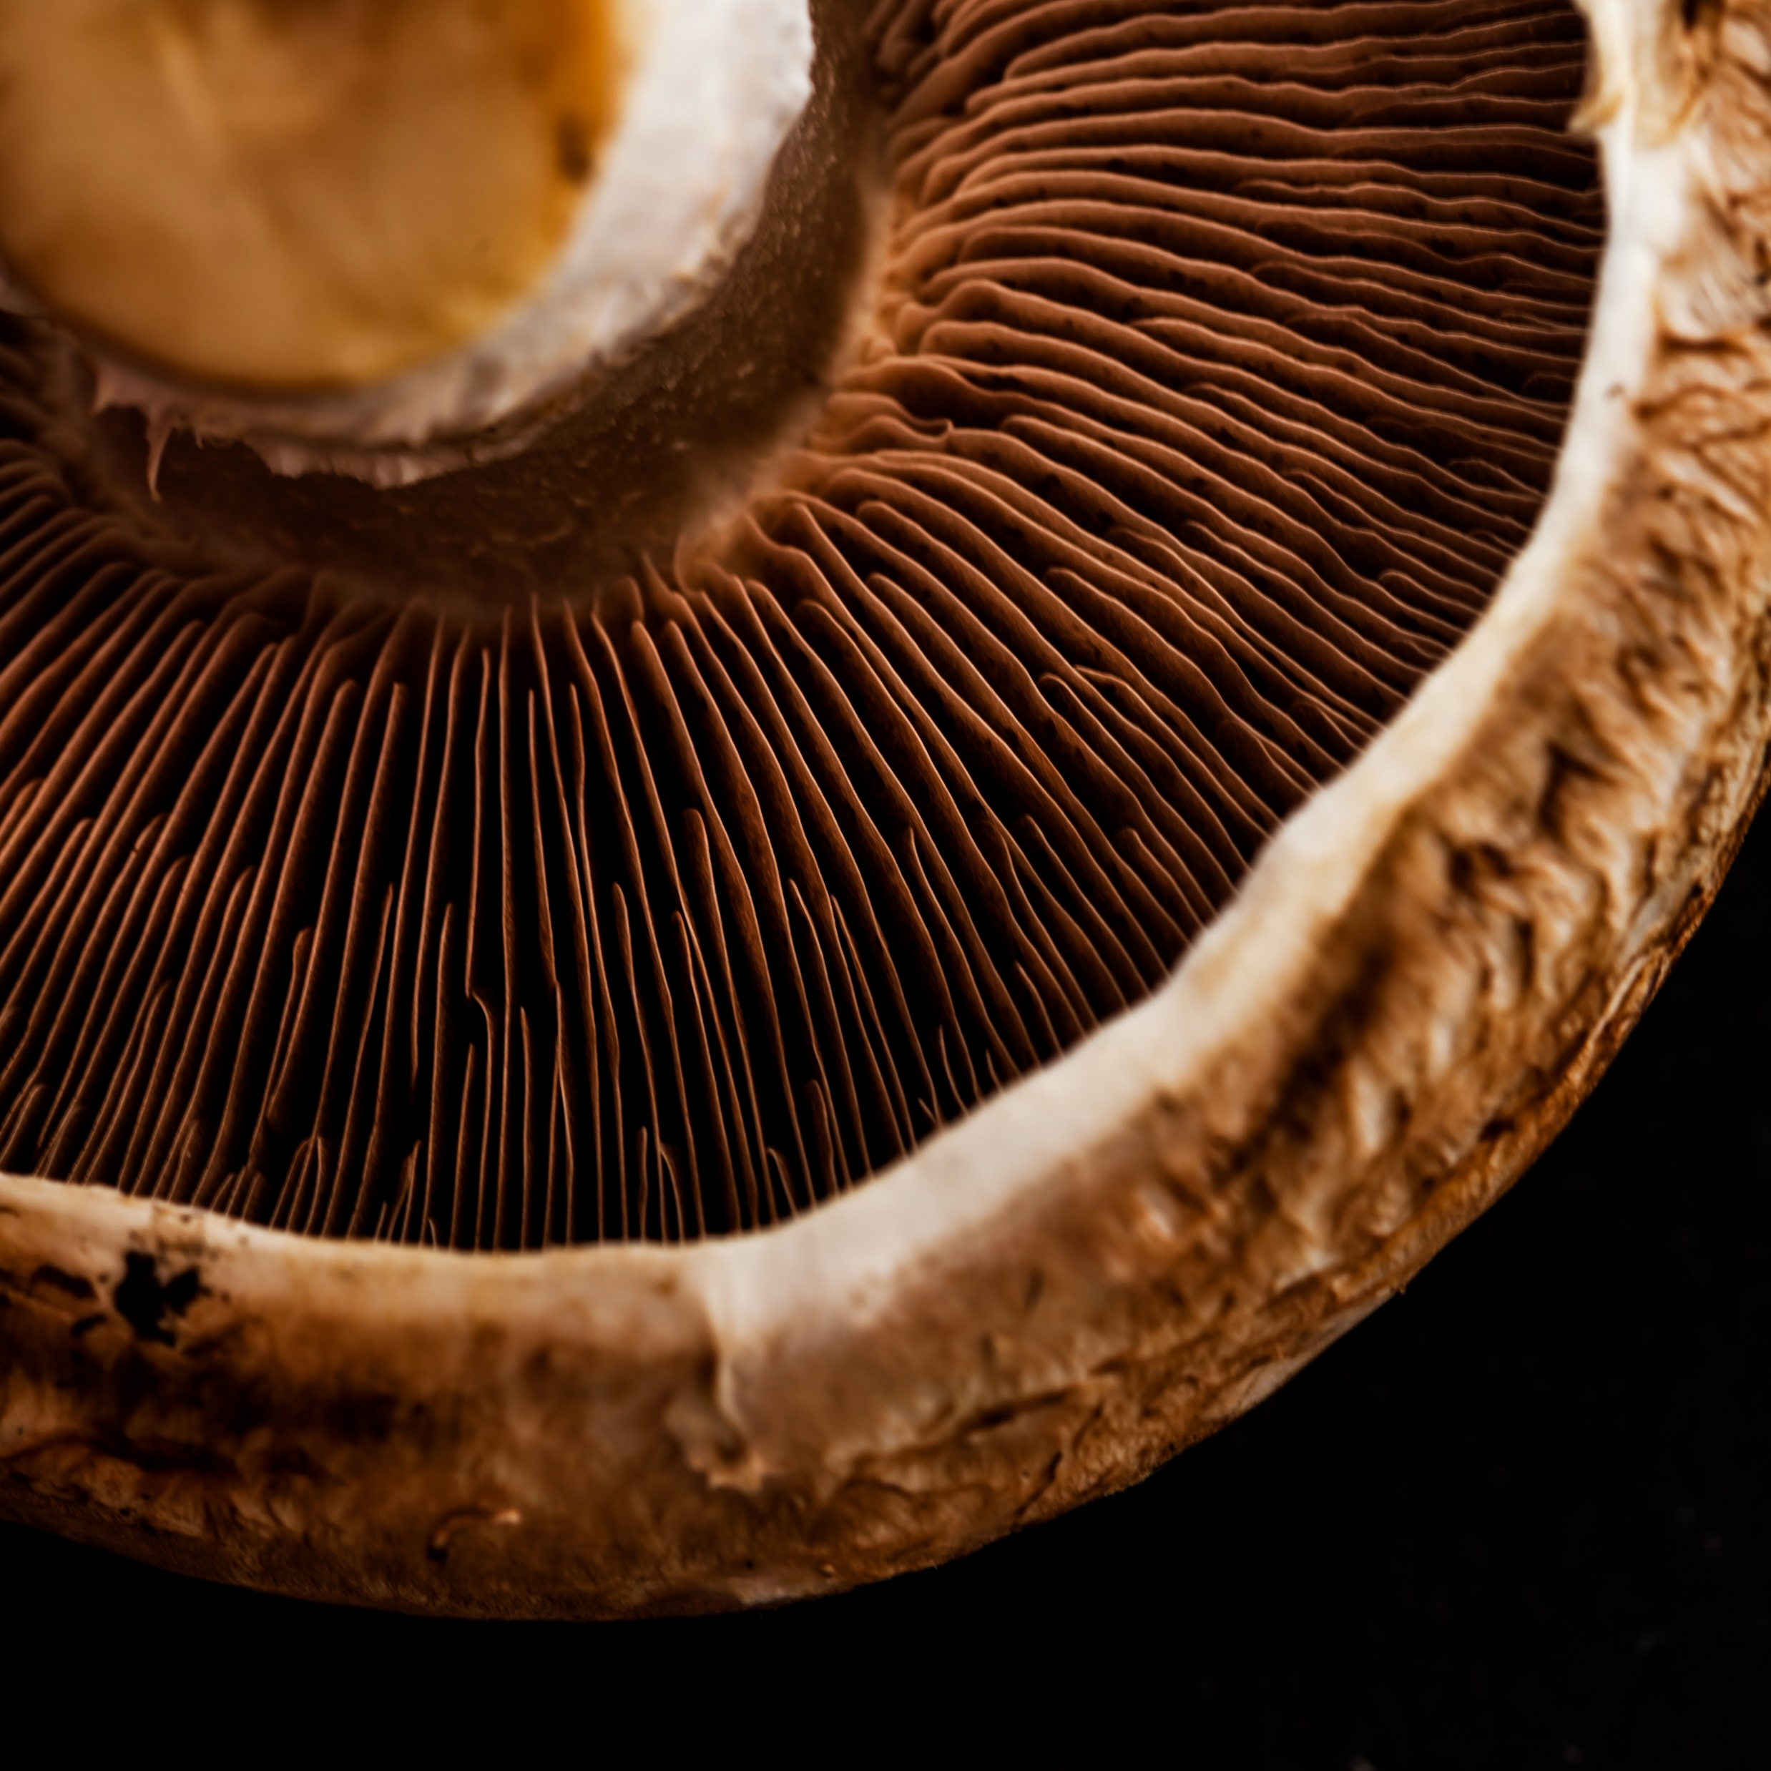
Goals
Revise MOSCOW prioritization
EU Allergen regulations
MVP progress
Merger between teams
Ideation
UI solutions
Flutter and AR integration
What’s next?

Slide 3
Revise MOSCOW table
MUST
Set preferences
Scan Product
SHOULD
Edit basket
Recommendations
COULD
Shopping list
Payment option
WOULD NOT
Warnings
View basket
Hide product categories
Locate products
Navigation

Slide 4
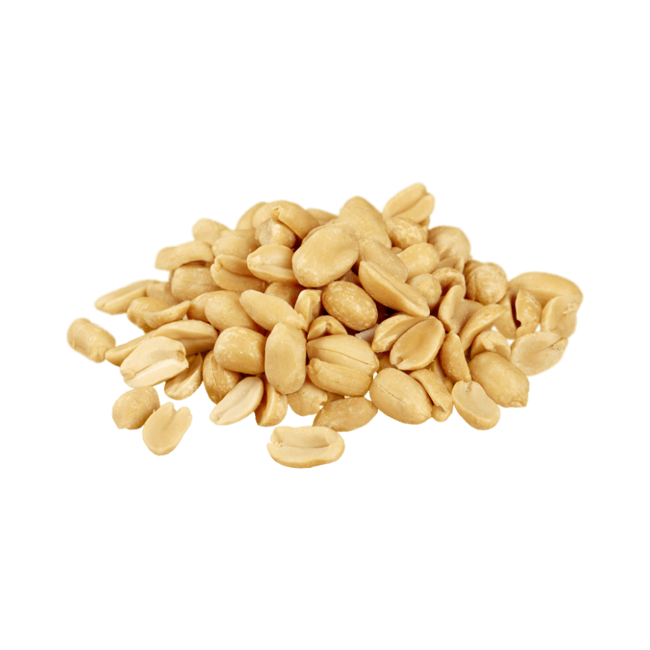
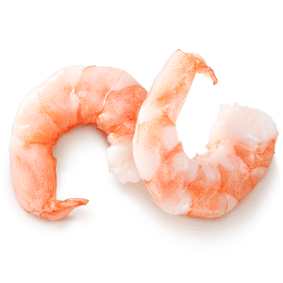
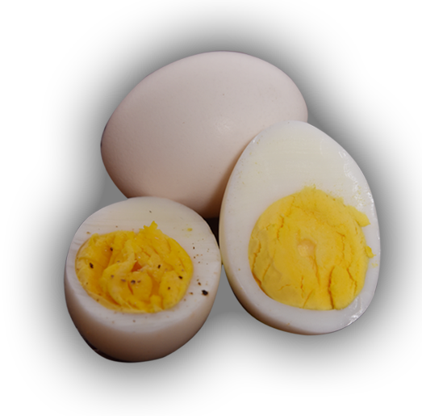
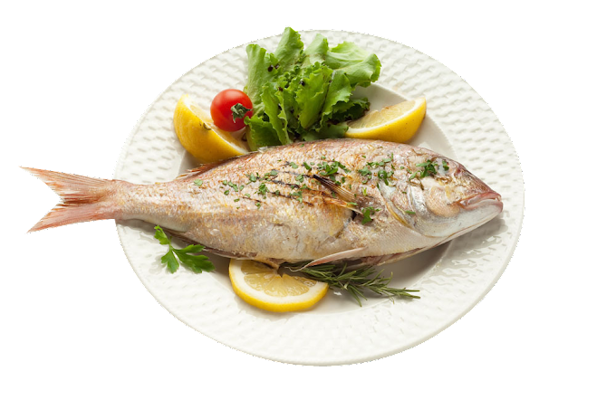
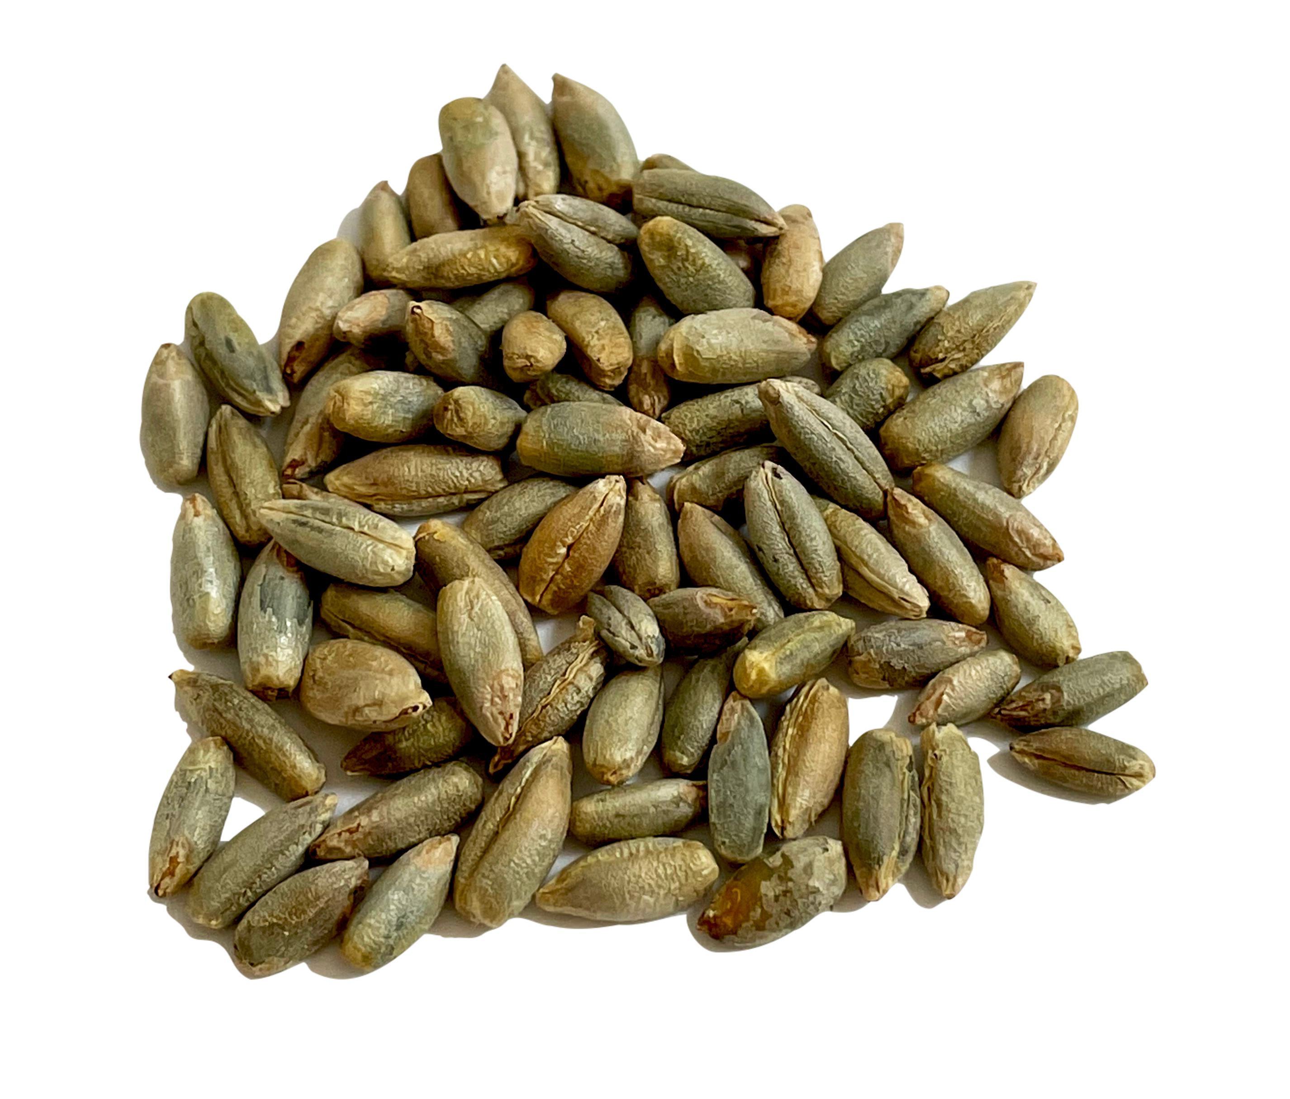
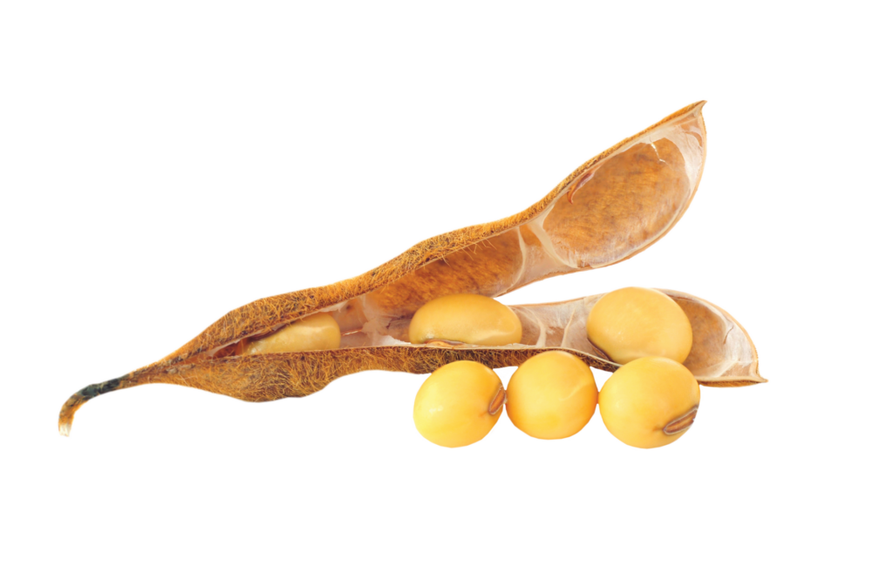
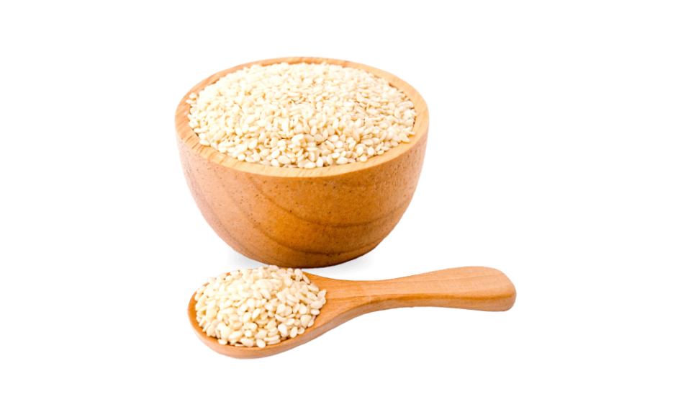
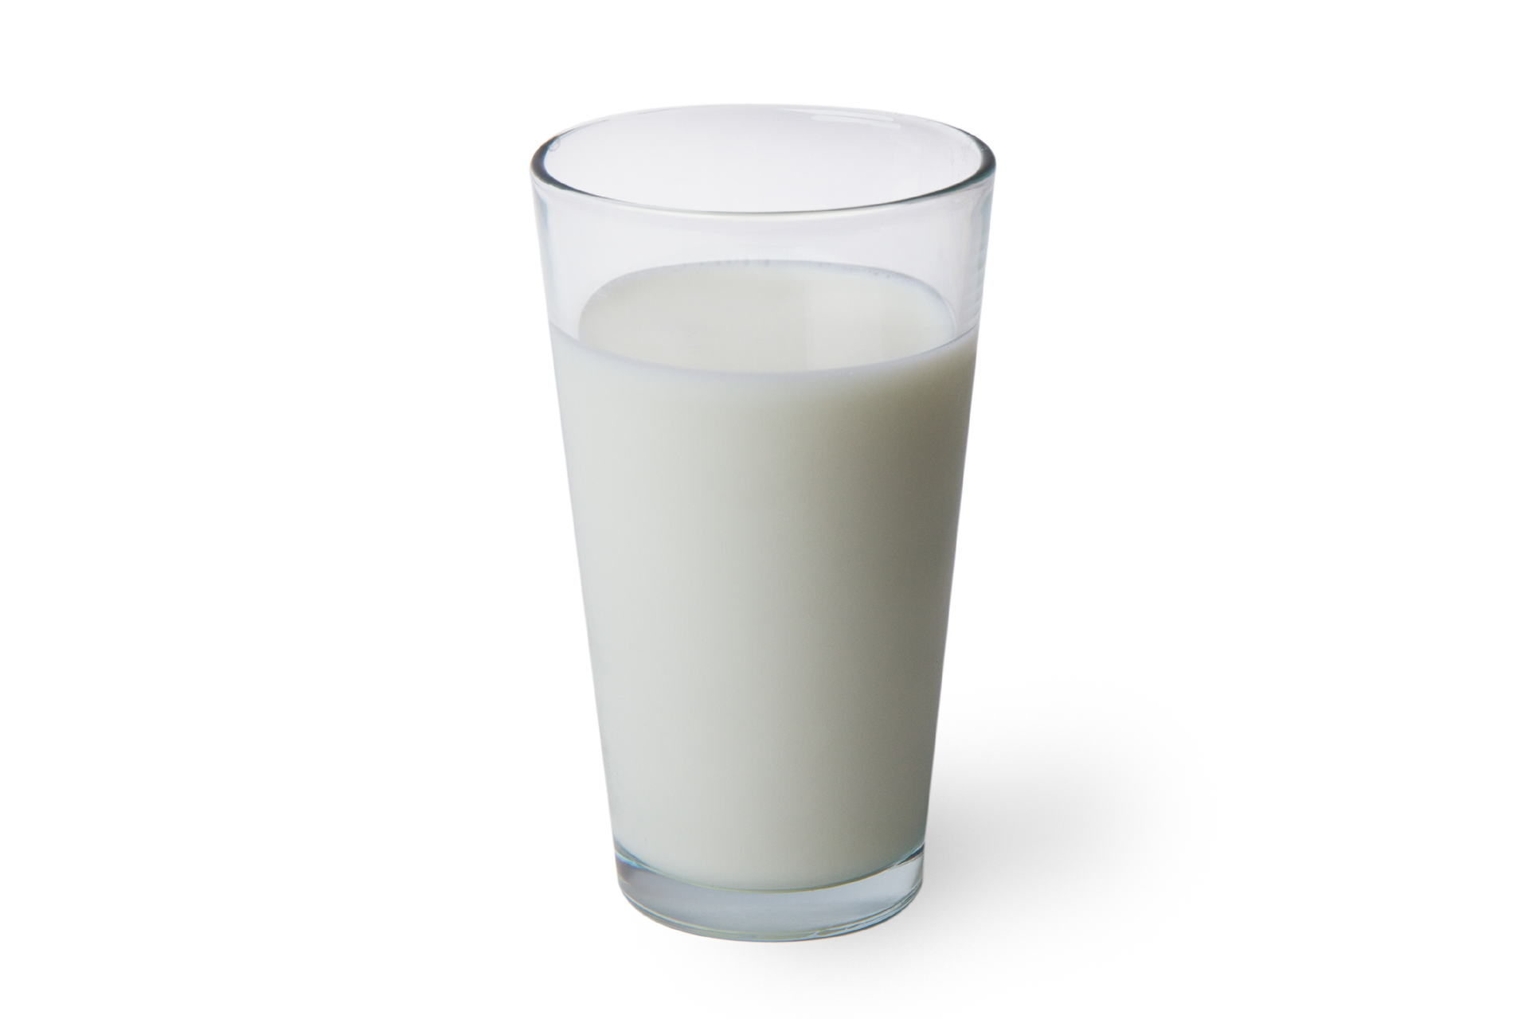
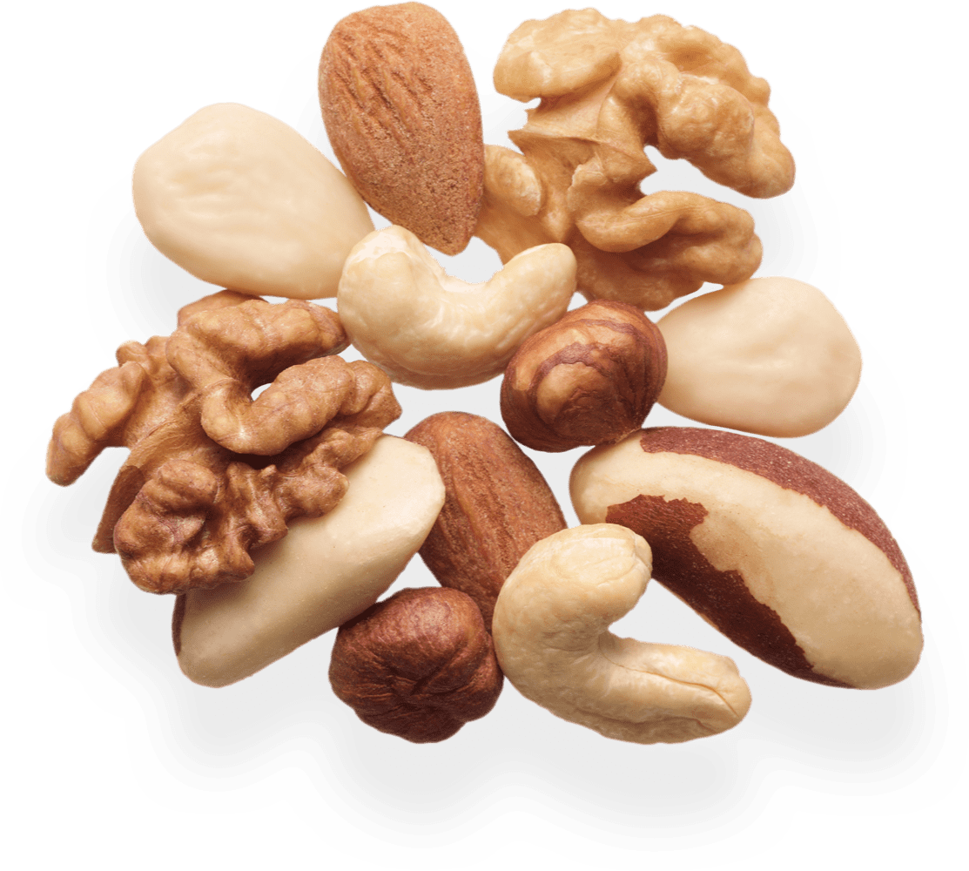
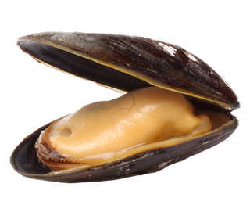
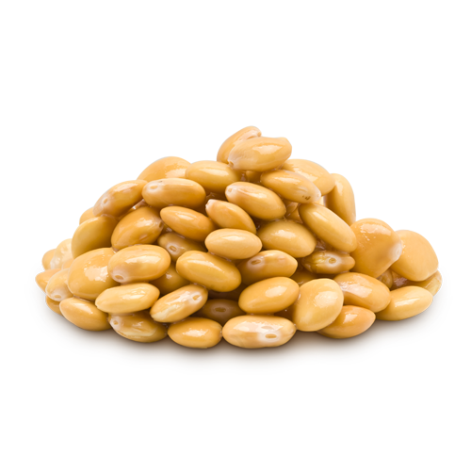
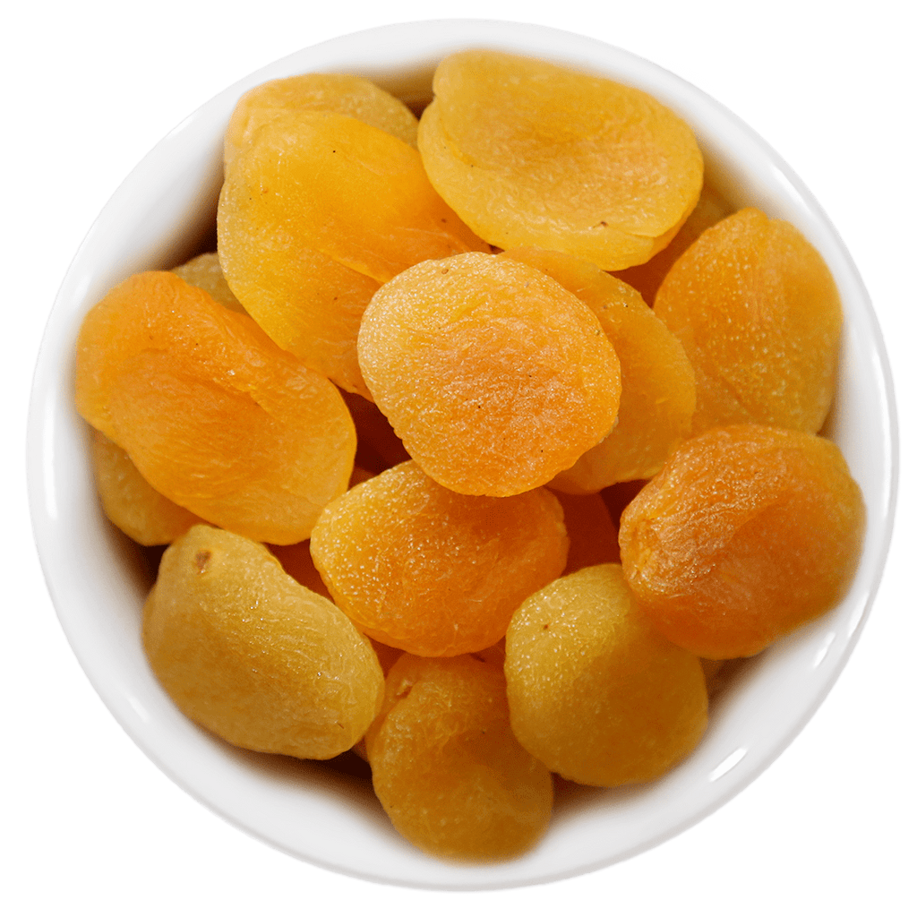
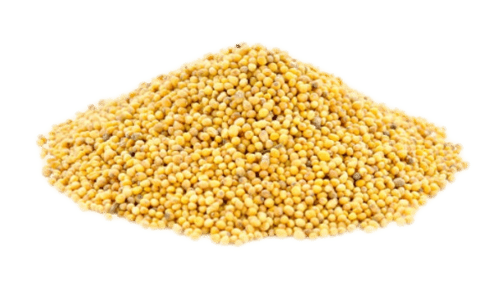
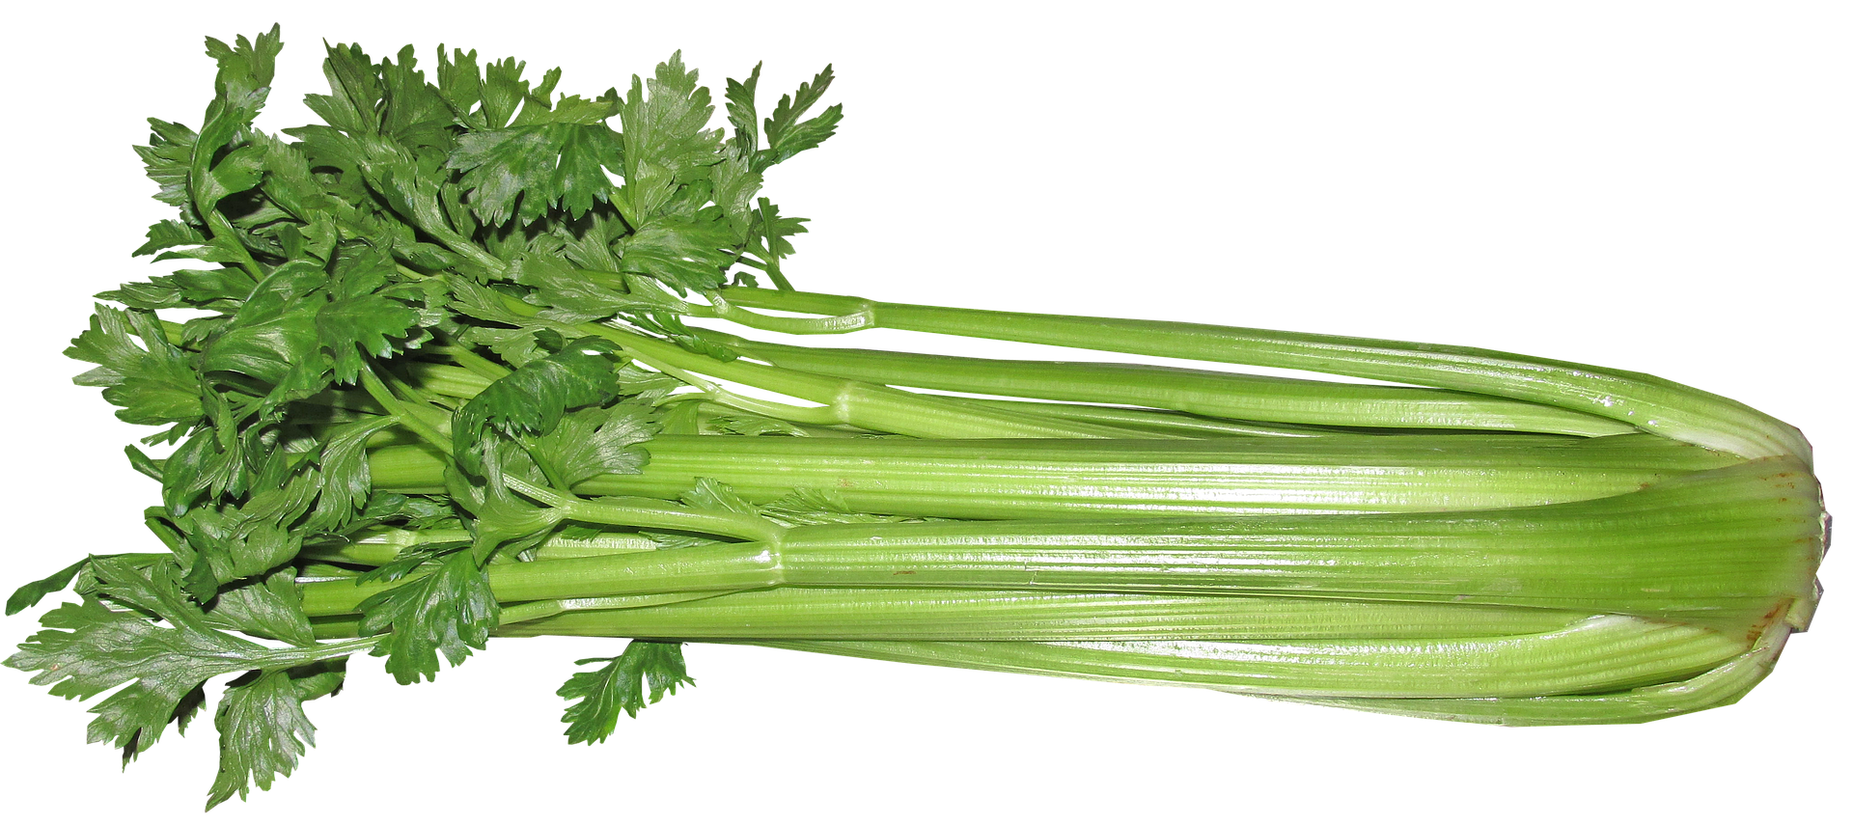
Allergens
Notes:
Cereals, Crustaceans, Peanuts, Soybeans , Milk, Fish, Eggs,
Nuts, Celery, Mustard, Sesame seeds, Sulphur dioxide and sulphites
Lupin, Mollusks

Slide 5

MVP progress

Slide 6
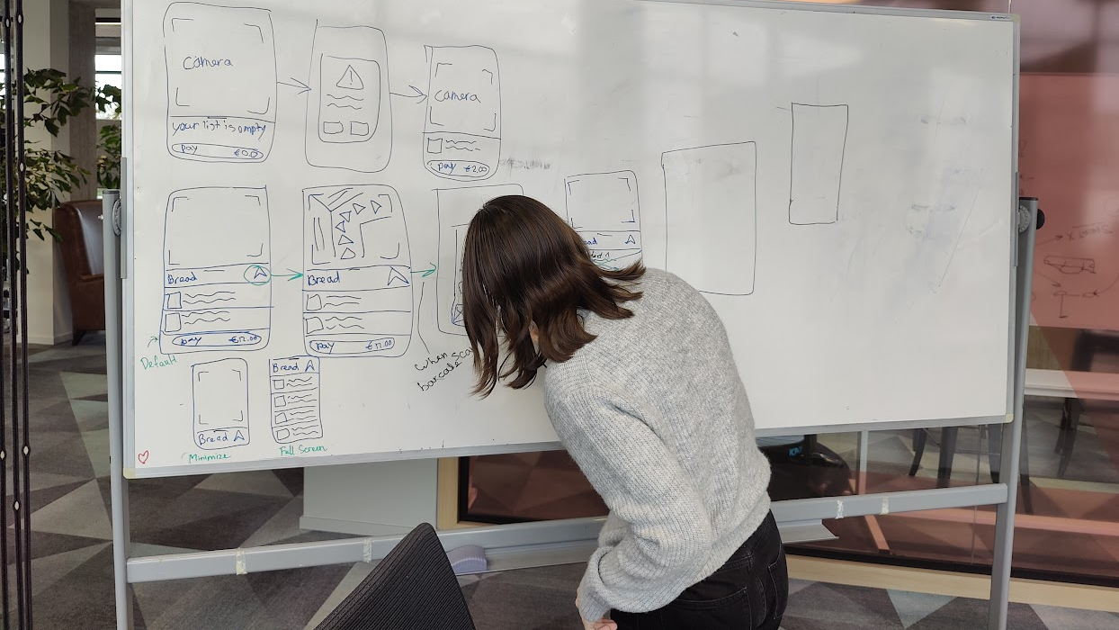
The Merger
Ideation

Slide 7
KAREL is back!
Notes:
One application that offers online shopping but IN STORE, with personalized allergen information and AR navigation. Accommodates two flows: with shopping list and without.

Slide 8
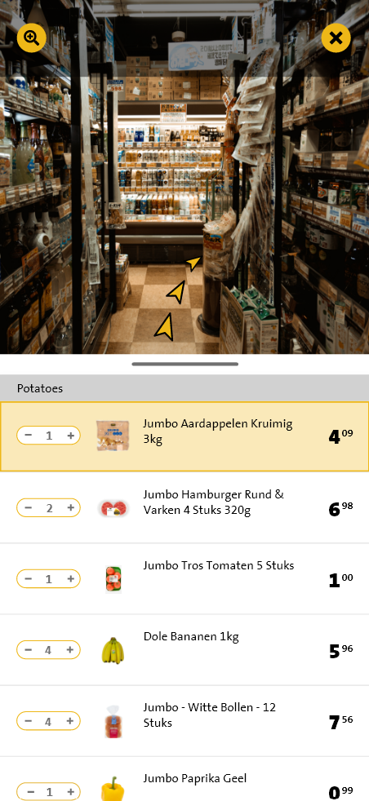
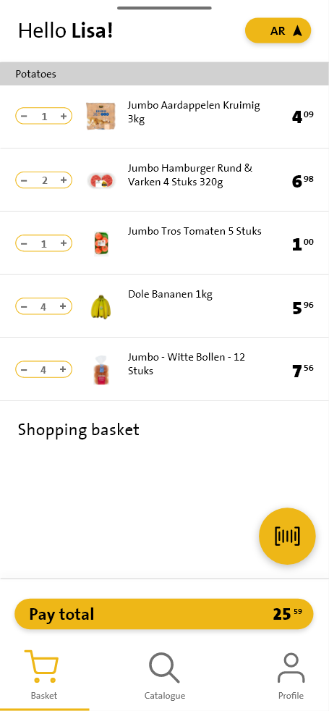
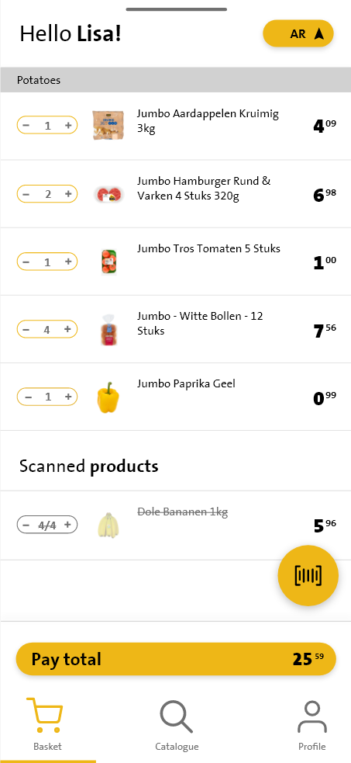
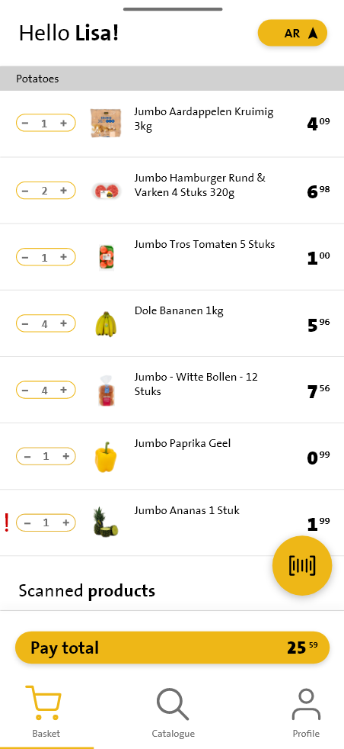
UI solutions

Slide 9
Flutter and AR integration

Slide 10
QR code scanner in ARkit

Slide 11
What’s next?
Yellow Team |  | Green Team
Routes |  | Allergen information
Navigation |  | Displaying the navigation
Integrate barcode scanner to AR |  | Usability Testing
Barcode instead of QR code |  | Improve MVP

